Slide 1

INTRODUCTION
Steady State Stability
Power System Stability:
Power system consists some synchronous machines operating in synchronism. For the continuity of the power system, it is necessary that they should maintain perfect synchronism under all steady state conditions. When the disturbance occurs in the system, the system develops a force due to which it becomes normal or stable.
The ability of the power system to return to its normal or stable conditions after being disturbed is called stability. Disturbances of the system may be of various types like sudden changes of load, the sudden short circuit between line and ground, line-to-line fault, all three line faults, switching, etc.

Slide 2
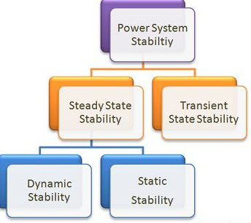
Steady State Stability
The stability of the system mainly depends on the behaviour of the synchronous machines after a disturbance. The stability of the power system is mainly divided into two types depending upon the magnitude of disturbances
→ Steady state stability
→ Transient stability

Slide 3
Steady State Stability
Steady-state stability – It refers to the ability of the system to regain its synchronism (speed & frequency of all the network are same) after slow and small disturbance which occurs due to gradual power changes. Steady-state stability is subdivided into two types
Dynamic stability – It denotes the stability of a system to reach its stable condition after a very small disturbance (disturbance occurs only for 10 to 30 seconds). It is also known as small signal stability. It occurs mainly due to the fluctuation in load or generation level.
Static stability – It refers to the stability of the system that obtains without the aid (benefit) of automatic control devices such as governors and voltage regulators.
Transient Stability – It is defined as the ability of the power system to return to its normal conditions after a large disturbance. The large disturbance occurs in the system due to the sudden removal of the load, line switching operations; fault occurs in the system, sudden outage of a line, etc.

Slide 4


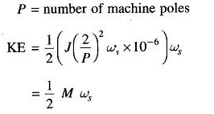
Steady State Stability
Dynamics of a Synchronous Machine:
Dynamics of a Synchronous Machine – kinetic energy of the rotor at synchronous machine is
Where ws = (P/2) wsm,
But,

Slide 5



Steady State Stability
Where,
We shall define the inertia constant H such that,
Where,

Slide 6
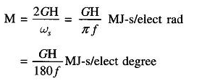
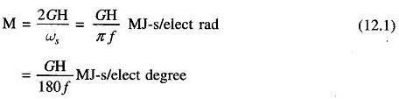
Steady State Stability
It immediately follows that,
M is also called the inertia constant.
Taking G as base, the inertia constant in pu is
M(P.U) =
H/(Pi.f) = H/(180.f)
i

Slide 7

Steady State Stability
Swing Equation:
It is assumed that the windage, friction and iron-loss torque is negligible. The differential equation governing the rotor dynamics can then be written as
The transient stabiity of the system can be determined by the help of the swing equation. Let θ be the angular position of the rotor at any instant t. θ is continuously changing with time, and it is convenient to measure it with respect to the reference axis shown in the figure below. The angular position of the rotor is given by the equation

Slide 8
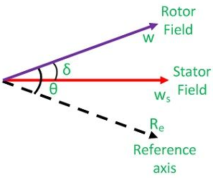
Constructing Y_{bus} for power-flow analysis
Steady State Stability

Slide 9
Steady State Stability
Load angle (or Torque angle) Ɵ: For a synchronous generator, the magnetic field rotates at synchronous speed and the rotating magnetic field is created in the stator. These two fields are not fully aligned. The stator field lags the rotating field. This lagging expressed in angle is called load angle.
Power angle δ : For a generator, the power angle is the difference between the generator induced voltage and the generator terminal voltage. The value of the power angle is same as the load angle. So, in context of generator, power angle and load angle mean same thing. For the case of transmission line the power angle is the angle between the angles of the voltages at two different points (bus). The transfer of power between the two points of power system is proportional to the sine of this angle.

Slide 10



Steady State Stability
Where,
θ – angle between rotor field and a reference axis w_{s} – synchronous speed δ – angular displacement
Differentiation of equation (1) give
Differentiation of equation (2) gives

Slide 11

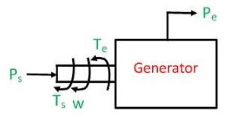

Steady State Stability
Angular acceleration of rotor
Power flow in the synchronous generator is shown in the diagram below. If the damping is neglected the accelerating torques, T_{a} in a synchronous generator is equal to the difference of mechanical input shaft and the electromagnetic output torque, i.e.,

Slide 12

Steady State Stability
Where,
T_{a} – accelerating torque T_{s} – shaft torque T_{e} – electromagnetic torque
Angular momentum of the rotor is expressed by the equation
M = Jw ---------------------- 6
Where,
w- the synchronous speed of the rotor J – moment of inertia of the rotor M – angular momentum of the rotor
Multiplying both the sides of equation (5) by w we get

Slide 13
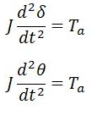


Steady State Stability
Where,
P_{s} – mechanical power input P_{e} – electrical power output P_{a} – accelerating power
But,
Equation (7) gives the relation between the accelerating power and angular acceleration. It is called the swing equation. Swing equation describes the rotor dynamics of the synchronous machines and it helps in stabilizing the system.

Slide 14
Steady State Stability
Steady State Stability:
As an introduction, we need to know about power state stability. It is really the capability of the system to return to its steady state condition after subjected to certain disturbances. We can now consider a synchronous generator to understand the power system stability. The generator is in synchronism with the other system connected to it. The bus connected to it and the generator will have same phase sequence, voltage and the frequency. So, we can say that the power system stability here is the capability of the power system to come back to its steady condition without affecting synchronism when subjected to any disturbances. This system stability is classified into – Transient Stability, Dynamic Stability and Steady State Stability.

Slide 15
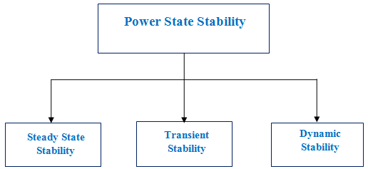
Steady State Stability
It is the study which implies small and gradual variations or changes in the working state of the system. The purpose is to determine the higher limit of loading in the machine before going to lose the synchronism. The load is increased slowly.
The highest power which can be transferred to the receiving end of the system without affecting the synchronism is termed as Steady State Stability limit.

Slide 16
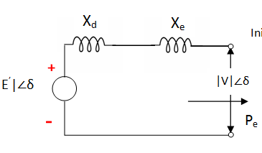
Steady State Stability

Slide 17
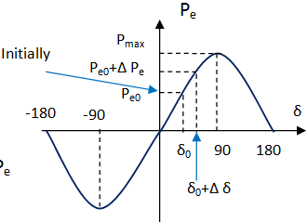
Steady State Stability

Slide 18


Steady State Stability
The Swings equation is known by
P_{m} → Mechanical power P_{e} → Electrical power δ → Load angle H → Inertia constant ω_{s} → Synchronous speed

Slide 19

Steady State Stability
Consider the above system (figure above) which is operating on steady state power transfer of
Assume the power is increased by a small amount say Δ P_{e}. As a result, the rotor angle becomes
from δ₀.

Slide 20
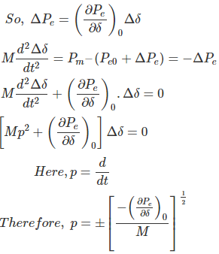
Steady State Stability

Slide 21
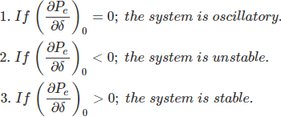
Steady State Stability
p → frequency of oscillation. The characteristic equation is used to determine the system stability due to small changes.
Conditions for System Stability

Slide 22

Steady State Stability
Without loss of stability, the Maximum power transfer is given by
Assume, the condition when the system is in operation with lower than the steady state stability limit. Then, it may oscillate continuously for a lengthy time if the damping is very low.

Slide 23
Steady State Stability
The oscillation which persists is a hazard to system security. The |V_{t}| should be kept constant for each load by adjusting the excitation. This is to maintain the steady state stability limit.
A system can never be operated higher than its steady state stability limit but it can operate beyond the transient stability limit.
By reducing the X (reactance) or by raising the |E| or by increasing the |V|, the improvement of steady state stability limit of the system is possible.
Two systems to improve the stability limit are quick excitation voltage and higher excitation voltage.
To reduce the X in the transmission line which is having high reactance, we can employ parallel line.

Slide 24
Steady State Stability
Transfer reactance:
Transfer reactance is the reactance between sending end node and receiving end node under fault conditions.
X – transfer reactance
E- sending end voltage
V- receiving end voltage

Slide 25
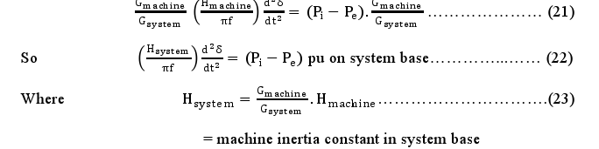
Steady State Stability
Multi Machine System:-
In a multi machine system a common base must be selected. Let Gmachine = machine rating (base)
Gsystem = system base
From swing equation we can write

Slide 26



Steady State Stability
Machines Swinging in Unison (Coherently) :-
Let us consider the swing equations of two machines on a common system base, i.e.,
Since the machines rotor swing in unison,

Slide 27
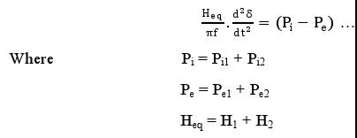

Steady State Stability
Simplifying above all equations
Equivalent inertia Heq can be expressed as:

Slide 28
Steady State Stability
A 60 Hz, 4 pole turbo-generator rated 100MVA, 13.8 KV has inertia constant of 10 MJ/MVA.
Find stored energy in the rotor at synchronous speed.
If the input to the generator is suddenly raised to 60 MW for an electrical load of 50 MW, find rotor acceleration.
If the rotor acceleration calculated in part (b) is maintained for 12 cycles, find the change in torque angle and rotor speed in rpm at the end of this period.
Another generator 150 MVA, having inertia constant 4 MJ/MVA is put in parallel with above generator. Find the inertia constant for the equivalent generator on a base 50 MVA.

Slide 29
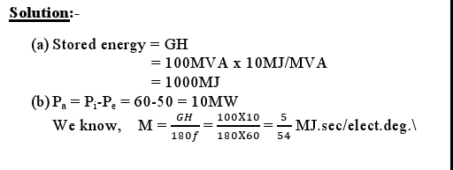
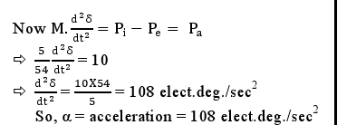

Steady State Stability

Slide 30
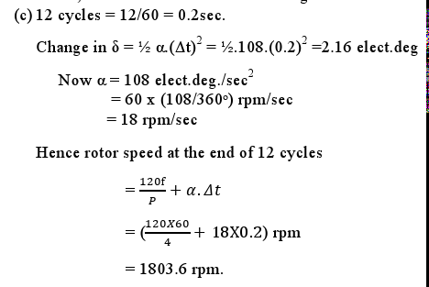
Steady State Stability
Example2:- Find the maximum steady-state power capability of a system consisting of a generator equivalent reactance of 0.4pu connected to an infinite bus through a series reactance of 1.0 p.u. The terminal voltage of the generator is held at1.10 p.u. and the voltage of the infinite bus is 1.0 p.u.

Slide 31
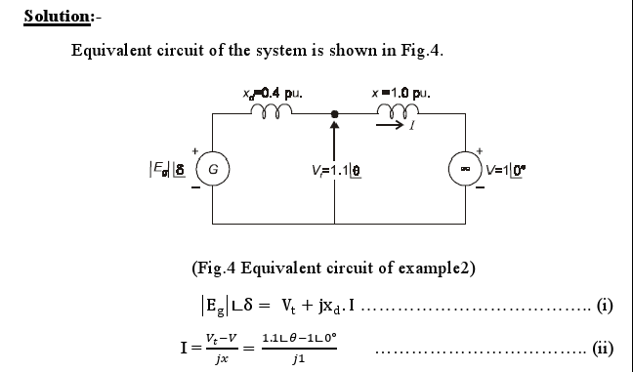
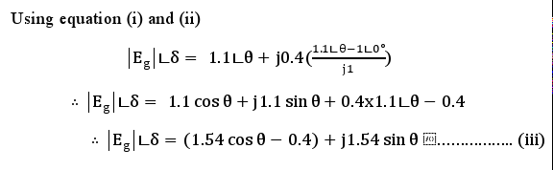
Steady State Stability

Slide 32
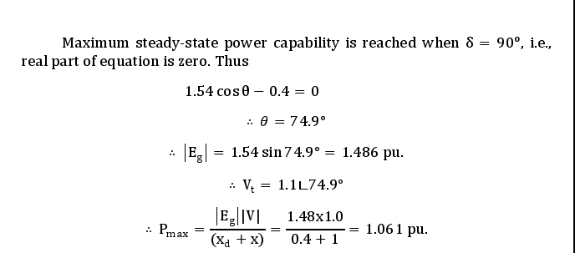
Steady State Stability

Slide 33
Steady State Stability
Synchronizing Power and Torque Coefficient
Definition: – Synchronizing Power is defined as the varying of the synchronous power P on varying in the load angle δ. It is also called Stiffness of Coupling, Stability or Rigidity factor. It is represented as P_{syn}. A synchronous machine, whether a generator or a motor, when synchronised to infinite Busbars has an inherent tendency to remain in Synchronism.
Consider asynchronous generator transferring a steady power P_{a} at a steady load angle δ₀. Suppose that, due to a transient disturbance, the rotor of the generator accelerates, resulting from an increase in the load angle by dδ. The operating point of the machine shifts to a new constant power line and the load on the machine increases to P_{a} + δP.

Slide 34
Steady State Stability
The steady power input of the machine does not change, and the additional load which is added decreases the speed of the machine and brings it back to synchronism.
Similarly, if due to a transient disturbance, the rotor of the machine retards resulting a decrease in the load angle. The operating point of the machine shifts to a new constant power line and the load on the machine decreases to (P_{a} – δP). Since the input remains unchanged, the reduction in load accelerates the rotor. The machine again comes in synchronism.
The effectiveness of this correcting action depends on the change in power transfer for a given change in load angle. The measure of effectiveness is given by Synchronising Power Coefficient.

Slide 35

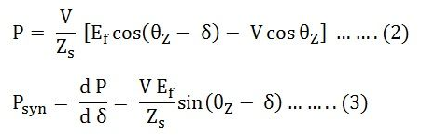
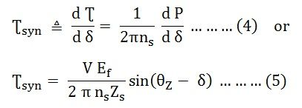
Steady State Stability
Power output per phase of the cylindrical rotor generator
The synchronising torque coefficient

Slide 36
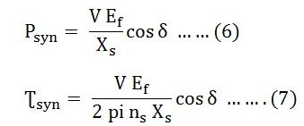
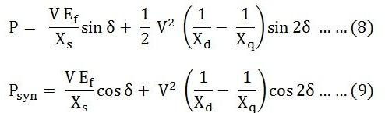
Steady State Stability
In many synchronous machines Xs>> R. Therefore, for a cylindrical rotor machine, neglecting saturation and stator resistance equation (3) and (5) becomes
For a salient pole machine

Slide 37

Steady State Stability
Unit of Synchronizing Power Coefficient P_{syn}
The synchronising Power Coefficient is expressed in watts per electrical radian.
Therefore,
Since, π radians = 180⁰
1 radian = 180/π degrees

Slide 38
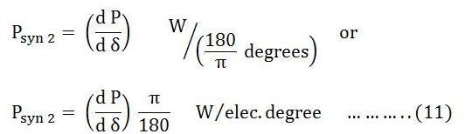


Steady State Stability
If P is the total number of pair of poles of the machine.
Synchronising Power Coefficient per mechanical radian is given by the equation shown below.

Slide 39

Steady State Stability
Synchronising Power Coefficient per mechanical degree is given as
Synchronising Torque Coefficient:
Synchronising Torque Coefficient gives rise to the synchronising torque coefficient at synchronous speed. That is, the Synchronizing Torque is the torque which at synchronous speed gives the synchronising power. If Ʈ_{syn} is the synchronising torque coefficient than the equation is given as shown below.

Slide 40
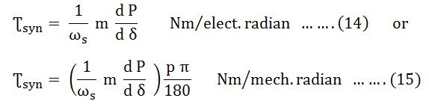

Steady State Stability
m is the number of phases of the machine
ω_{s} = 2 π n_{s}
n_{s} is the synchronous speed in revolution per second

Slide 41
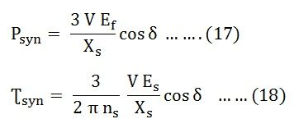
Steady State Stability
Significance of Synchronous Power Coefficient:
The Synchronous Power Coefficient P_{syn} is the measure of the stiffness between the rotor and the stator coupling. A large value of P_{syn} indicates that the coupling is stiff or rigid. Too rigid a coupling means and the machine will be subjected to shock, with the change of load or supply. These shocks may damage the rotor or the windings. We have,

Slide 42
Steady State Stability
The above two equations (17) and (18) show that P_{syn} is inversely proportional to the synchronous reactance. A machine with large air gaps have relatively small reactance. The synchronous machine with the larger air gap is stiffer than a machine with a smaller air gap. Since P_{syn} is directly proportional to E_{f}, an overexcited machine is stiffer than an under the excited machine.
The restoring action is great when δ = 0, that is at no load. When the value of δ = ± 90⁰, the restoring action is zero. At this condition, the machine is in unstable equilibrium and at steady state limit of stability. Therefore, it is impossible to run a machine at the steady state limit od stability since its ability to resist small changes is zero unless the machine provided with special fast acting excitation system.

Slide 43
Steady State Stability
Methods of improving stability
when the maximum power limit of various power-angle curves is raised, the accelerating area decreases and decelerating area increases for a given clearing angle. Consequently, δ0 is decreased and δm 1s increased. This means that by increasing P_{max} the rotor can swing through a larger P_{max} increases the critical clearing time and improves stability.
The steady-state power limit is given by
P_{max}=EV/X
It can be seen from this expression that P max can be increased by increasing either or both V and E and reducing the transfer reactance. The following methods are available for reducing the transfer reactance:

Slide 44
Steady State Stability
1. Operate Transmission Lines in Parallel
By operating transmission lines in parallel reactance decreases and power increases.
2. Use of Double-Circuit Lines
The impedance of a double-circuit line is less than that of a single-circuit line. A double-circuit line doubles the transmission capability. An additional advantage is that the continuity of supply is maintained over one line with reduced capacity when the other line is out of service for maintenance or repair. But the provision of additional line can hardly be justified by stability consideration alone.

Slide 45
Steady State Stability
3. Use of Bundled Conductors
Bundling of conductors reduces to a considerable extent the line reactance and so increases the power limit of the line.
4. Series Compensation of the Lines
The inductive reactance of a line can be reduced by connecting static capacitors in with the line.It is to be noted that any measure to increase the steady-state limit Pmax will improve the transient stability limit. The use of generators of high inertia and low reactance improves the transient stability, but generators with these characteristics are costly. In practice, only those methods are used which are economical.

Slide 46
Steady State Stability
5. High-Speed Excitation Systems
High-Speed excitation helps to maintain synchronism during a fault by quickly increasing the excitation voltage. High-speed governors help by quickly adjusting the generator inputs.
6. Fast Switching
Rapid isolation of faults is the principal way of improving transient stability. The fault should be cleared as fast as possible. It so the time required for fault removal is the sum of relay response time plus the circuit breaker operating time. Therefore, high speed relaying and circuit breaking are commonly used to improve stability during fault conditions. It has now become possible to isolate the fault in less than two cycles (that is. 0.04 s for 50 Hz system). System stability can be further improved by making circuit-breaker reclosure automatic,

Slide 47
Steady State Stability
as many faults do not re-establish themselves after restoration of supply. The time interval between removal and reclosure should be reduced keeping in mind that the line must remain de-energized for a certain minimum time in order that the line insulation should recover fully.
7.Breaking Resistors
In this method an artificial electric load in the form of shunt resistors is temporarily connected at or near the generator bus. Such resistors partially compensate the reduction of load on a generator following a fault. The acceleration of the generator rotor is therefore, reduced. For this reason, these resistors are called braking resistors. This method is also known as dynamic braking. A control scheme connects the through circuit breakers.

Slide 48
Steady State Stability
The scheme also amounts of resistance to be connected and the duration of its connection. the braking resistors are connected immediately following the fault and remain in the circuit for few cycles. They are disconnected at the moment of enclosure when the system voltage has recovered.
8. Single-Pole Switching
Majority of the line faults are single line-to-ground (LG) faults. In single-pole switching (also called independent pole operation), the three phases of the circuit breaker are closed or opened independently of each other. In the event of an LG fault, the circuit breaker pole corresponding to the faulty line is opened and the remaining two healthy phases continue to transfer power. Since most of the faults are transitory, this phase can be reclosed after it has been open for a predetermined time.

Slide 49
Steady State Stability
The System should not be operated for long periods with one phase open. Therefore, provision should be made to trip the whole line if one phase remains open predetermined time .
9. HVDC Links
High voltage direct current (HVDC) links are helpful in maintain in stability the following advantages
A dc. tie line provides a loose coupling between two ac. Systems to be interconnected.
A d.c link may be interconnect two a.c systems at different frequencies.
There is no transfer of fault energy from one a.c. system to another if they are interconnected by a d.С. tie line.

Slide 50
Steady State Stability
10. Load Shedding
If there is insufficient generation to maintain system frequency, some of the generators are disconnected immediately or during after a fault. the stability of the remaining generators is improved. The unit to be disconnected is provided with a large steam bypass system. When the system recovers from the shock of the fault, the disconnected unit is resynchronized and reloaded. Extra cost of a large steam bypass system is the limitation of this method.

Slide 51
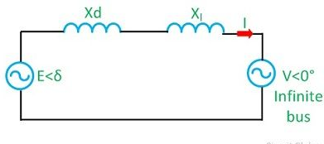
Steady State Stability
Power-Angle Curve
Consider a synchronous machine connected to an infinite bus through a transmission line of reactance X_{l} shown in a figure below. Let us assume that the resistance and capacitance are neglected.
Equivalent diagram of synchronous machine connected to an infinite bus through a transmission line of series reactance X_{l} is shown below:

Slide 52
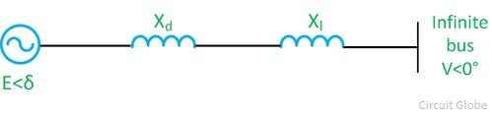
Steady State Stability
Let,
V = V<0⁰ – voltage of infinite bus
E = E<δ – voltage behind the direct axis synchronous reactance of the machine.
X_{d} = synchronous / transient resistance of the machine
The complex power delivered by the generator to the system is
S = VI

Slide 53

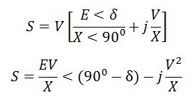

Steady State Stability
Active power transferred to the system

Slide 54



Steady State Stability
The reactive power transferred to the system
The maximum steady-state power transfers occur when δ = 0

Slide 55

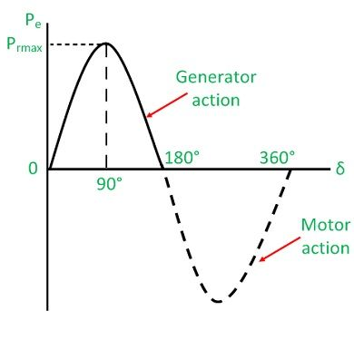
Steady State Stability
The graphical representation of P_{e} and the load angle δ is called the power angle curve. It is widely used in power system stability studies. The power angle curve is shown below

Slide 56
Steady State Stability
Power Angle Curve of synchronous machine is the graphical representation of electrical output with respect to the power angle. As we know, power angle is also known as load angle therefore it can be said that this curve is graphical representation of electrical output of generator with respect to load angle. In this article, we will discuss power angle curve and its importance.
First of all, we should know the mathematical relation between the electrical output of synchronous machine in terms of load angle to get the graph of power versus load angle. The electrical output of synchronous generator is given as below.

Slide 57
Steady State Stability
P_{e} = (EV/X)Sinδδ
Where E, V, X and δ are no load excitation voltage, generator terminal voltage, generator synchronous reactance and load angle respectively. You are requested to read “Power Flow Equation through an Inductive Load” for getting the detail of derivation part of the above expression of electrical output.
Let us now draw a graph between P_{e} and load angle δ assuming rest of the parameters to be constant

Slide 58
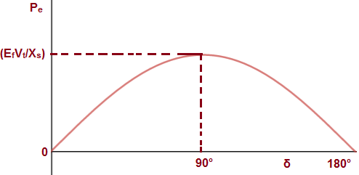
Steady State Stability
Above plot indicates the relation between power and power angle which may be effected during fault conditions

Slide 59
Steady State Stability
Above graphical representation of power w.r.t δ is called Power Angle Curve. It can be easily seen from the above graph that it is sinusoidal. Thus power angle curve is sinusoidal.
Importance of Power Angle Curve
Power Angle Curve tells us about the electrical power output of synchronous machine when power angle δ is varied. It can be seen from this curve that as we increase δ from 0 to 90°, the output increases sinusoidally. But a further increase in power angle δ beyond 90°, the generator electrical output decreases. What does this mean?

Slide 60
Steady State Stability
This simply means that, the generator electrical output is less than the mechanical input. Therefore, the poles of the machine will start to slip and eventually it will lose synchronism. Thus the machine i.e. generator becomes unstable. Steady state stability limit is the maximum power flows possible through a specific point without lose of synchronism, when the power is increased gradually. Therefore, steady state stability limit of synchronous machine corresponds to power for load angle δ = 90°. To be accurate, it will be (E_{f}V_{t}/X_{s}).
Not only steady state stability limit rather transient stability limit is also affected by the load angle at which machine is operating.

Slide 61
Steady State Stability
Transient state stability limit is basically the maximum amount of power flow possible without loss of synchronism when a sudden disturbance occurs. The transient stability limit is determined by Equal Area Criteria which uses power angle curve. Thus power angle curve is very important for study of stability limit of synchronous machine.

Slide 62
Steady State Stability
Example 1: A 50Hz, 4 pole turbo alternator rated 150 MVA, 11 kV has an inertia constant of 9 MJ / MVA. Find the (a) stored energy at synchronous speed (b) the rotor acceleration if the input mechanical power is raised to 100 MW when the electrical load is 75 MW, (c) the speed at the end of 10 cycles if acceleration is assumed constant at the initial value.
Example 2: Two 50 Hz generating units operate in parallel within the same plant, with the following ratings: Unit 1: 500 MVA, 0.8 pf, 13.2 kV, 3600 rpm: H = 4 MJ/MVA; Unit 2: 1000 MVA, 0.9 pf, 13.8 kV, 1800 rpm: H = 5 MJ/MVA. Calculate the equivalent H constant on a base of 100 MVA.

Slide 63
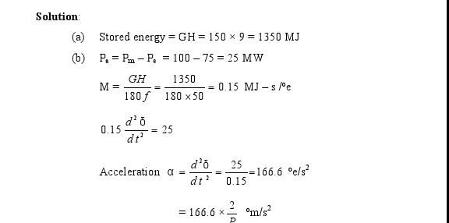
Steady State Stability

Slide 64
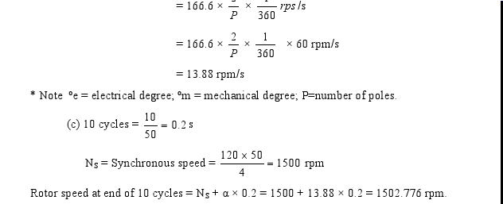
Steady State Stability

Slide 65
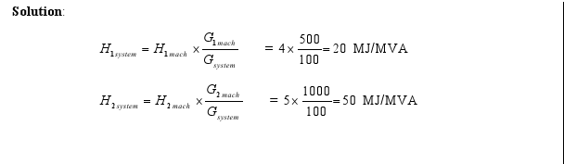
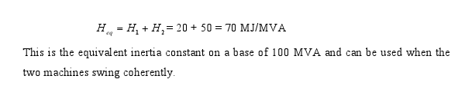
Steady State Stability

Slide 66
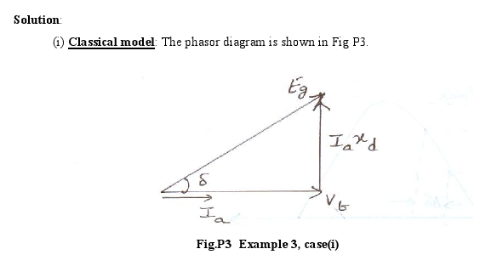
Steady State Stability
Example 3: Obtain the power angle relationship and the generator internal emf for (i) classical model (ii) salient pole model with following data: xd = 1.0 pu : xq = 0.6 pu : Vt = 1.0 pu : Ia = 1.0 pu at upf

Slide 67
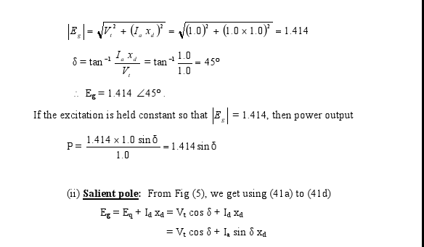
Steady State Stability

Slide 68
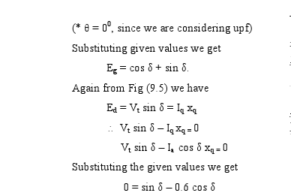
Steady State Stability

Slide 69
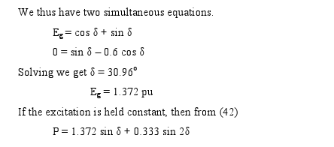
Steady State Stability

Slide 70
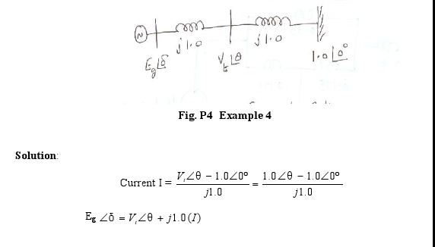
Steady State Stability
Example 4: Determine the steady state stability limit of the system shown in Fig 8, if Vt = 1.0 pu and the reactances are in pu.

Slide 71
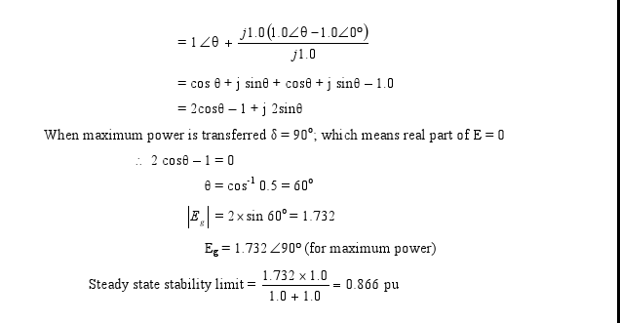
Steady State Stability

Slide 72
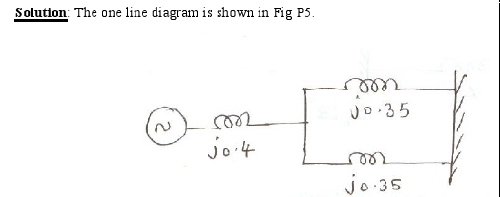
Steady State Stability
Example 5: A 50 Hz synchronous generator having an internal voltage 1.2 pu, H = 5.2 MJ/MVA and a reactance of 0.4 pu is connected to an infinite bus through a double circuit line, each line of reactance 0.35 pu. The generator is delivering 0.8pu power and the infinite bus voltage is 1.0 pu. Determine: maximum power transfer, Steady state operating angle, and Natural frequency of oscillation if damping is neglected.

Slide 73

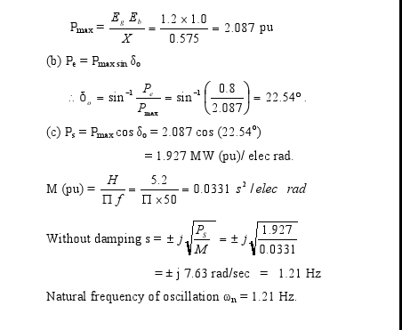
Steady State Stability

